Slide 1


CS 6301 – MACHINE LEARNING
DRIVER FATIGUE ANALYSIS
J Nithyasree ( 2021103027 )
PROJECT GUIDE:
Dr. MOHAMMED FATHIMAL
ASSISTANT PROFESSOR, DCSE
COLLEGE OF ENGINEERING, GUINDY

Slide 2
ABSTRACT
Road accidents frequently result from fatigued or sleepy drivers. More people die and are killed worldwide each year. Driver fatigue is a major factor in many accidents. It is currently one of the major causes of accidents.
Numerous facial expressions, such as frequent yawning, frequent eye blinking, and head positioning, might indicate how tired someone is. Computer vision is the most suitable and practical technology to solve this issue since it uses these sensory properties.
Combines traditional image processing methods and deep learning algorithms to achieve optimal performance.
Uses a diverse dataset of labelled facial images and video frames captured from a wide range of drivers under various driving conditions ensuring the model’s effectiveness across different scenarios, lighting conditions, and facial expressions.
The system's output includes real-time alerts to drivers when drowsy behaviour is detected, thereby contributing to road safety.

Slide 3
EXISTING SYSTEMS AND THEIR CHALLENGES
Infrared-based technologies to detect eye movements or facial features - Prone to false alarms or may not work well under varying lighting conditions.
A simple existing model for driver drowsiness detection uses OpenCV to detect facial landmarks and calculate the eye aspect ratio (EAR). This basic approach focuses on eye closure patterns to detect driver fatigue but may not capture nuanced cues or head pose variations.
CHALLENGES FACED:
Lack of Accuracy.
False alarms.
Environmental Sensitivity.
Lack of Real-Time Feedback.

Slide 4
LITERATURE REVIEW
Papers | Algorithm Used | Disadvantages
1. "Enhancing Driver Safety through Facial Recognition-Based Drowsiness Analysis" | Facial Landmark Tracking | Limited Robustness Real-time Processing Bottlenecks Lack of Individualization
2. "Evaluating Eye-tracking Algorithms for Driver Drowsiness Detection" | Pupil Tracking and Gaze Analysis | Pupil Tracking and Gaze Analysis Environmental Interference Limited Range of Eye Movements
3. "Machine Learning Approaches for Driver Drowsiness Prediction: A Comparative Analysis" | Ensemble Learning with Support Vector Machines and Random Forests | Overfitting Challenges Data Privacy Concerns Adaptability to Contextual Factors

Slide 5
PROBLEM DEFINITION
PROBLEM:
Drowsy driving poses a significant threat to road safety, leading to a substantial number of accidents and fatalities each year. The problem is to develop an advanced Driver Drowsiness Detection System that effectively identifies and alerts drivers when they exhibit signs of drowsy behavior using Machine Learning and Computer Vision Techniques.
DATASET :
Classes with various lighting conditions
Open eyes
Closed eyes
Yawn
No Yawn

Slide 6
OBJECTIVE
Developing a dependable model for precise drowsiness detection is pivotal in enhancing road safety.
Real-time alerts, a core feature, ensure timely intervention, and to achieve this, a diverse and representative dataset mirroring real-life scenarios is imperative.
The model's robustness under various conditions is crucial, ensuring its efficacy in diverse environments.
Striving to mitigate false alarms remains a key focus, enhancing the system's reliability.
Rigorous performance evaluation using diverse metrics is essential for gauging the model's effectiveness.
Ultimately, this endeavor aims to contribute significantly to the overarching goal of road safety enhancement.
Technological Fusion: Combines Machine Learning for interpretability and Deep Learning (CNNs) for complex pattern recognition.

Slide 7
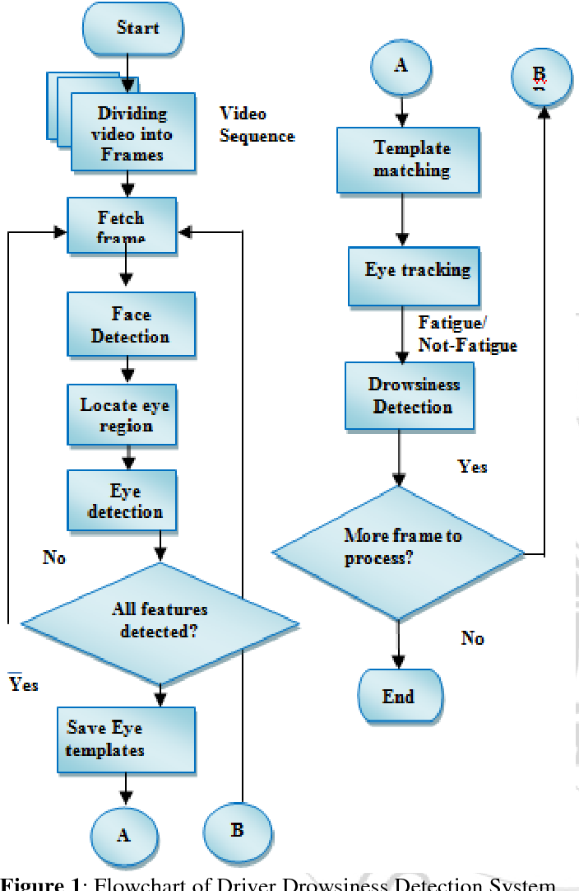
ARCHITECTURE DIAGRAM

Slide 8
S/W AND H/W SPECIFICATION
HARDWARE REQUIREMENTS
PROCESSOR : Intel Core i3 OR i5
RAM : 4GB or more RAM
MONITOR : 15” COLOR
HARD DISK : 250 GB
WEB CAMERA
SOFTWARE REQUIREMENTS
Application: Python 3.11
Deep Learning Framework: Tensorflow 3.11
Development Environment: Jupyter Notebook, Visual Studio Code

Slide 9
ALGORITHMS USED
Deep Learning (DL) Algorithm:
Sequential Model with Convolutional Neural Networks (CNN): Utilized to extract intricate patterns and features from facial images. Used to improve accuracy of detection.

Slide 10
TECHNICAL MODULES
Data collection
Data preprocessing
Model creation
Deployment

Slide 11
DATA COLLECTION
Required dataset is downloaded from Kaggle.
Dataset consists of images classified as closed, open, no yawn and yawn.
In each class around 500 images are found.
DATA PREPROCESSING
In this module images are resized into 200X200 and 600X600 pixels for effective processing and horizontally flipped images are sampled using augmentation .
Haar cascades are used for extracting eyes and face from the input images
Processed images are stored as NumPy array along with class labels
Dataset is divided into training and testing sets with test size of 0.30

Slide 12
MODEL CREATION
With this ensemble method an accuracy of 95 is obtained.
Convolutional neural networks are implemented for better performance.
Convolution layer and maxpooling layer pairs are implemented in between and flattening of neurons is implemented at last.
Adam optimisation is used along with Relu and softmax activation functions.
Model is trained for 50 epochs in GPU environment.

Slide 13
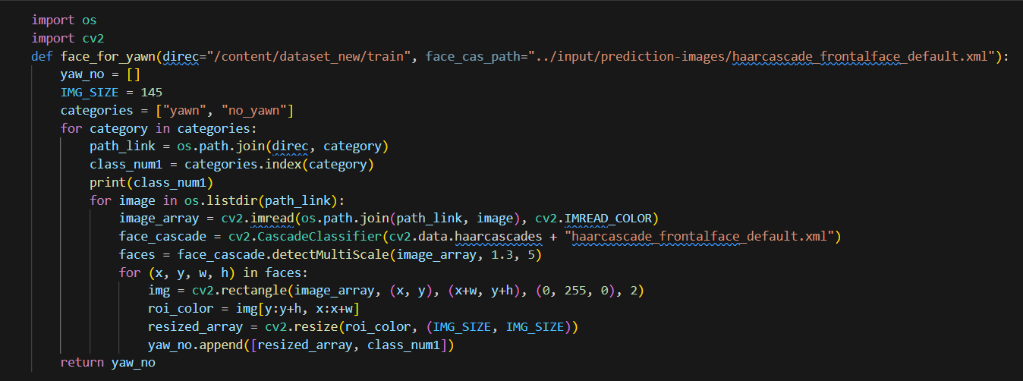
MODEL

Slide 14
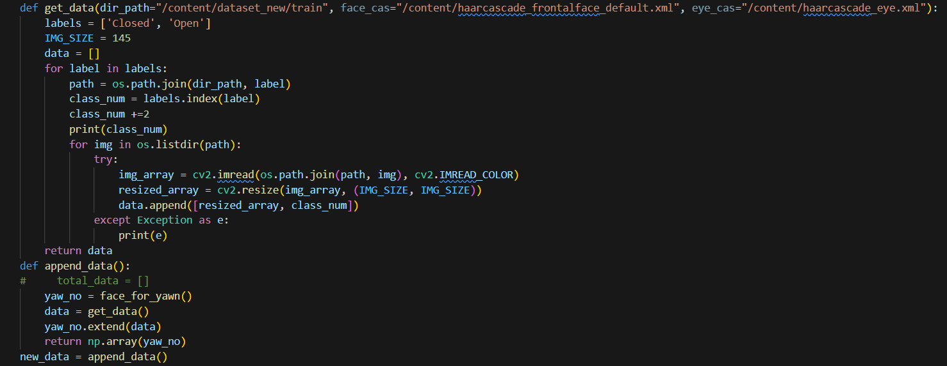

Slide 15
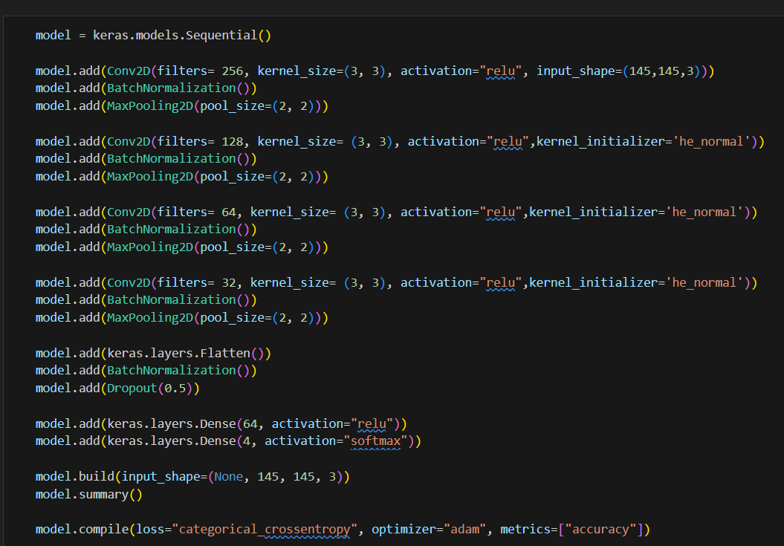

Slide 16
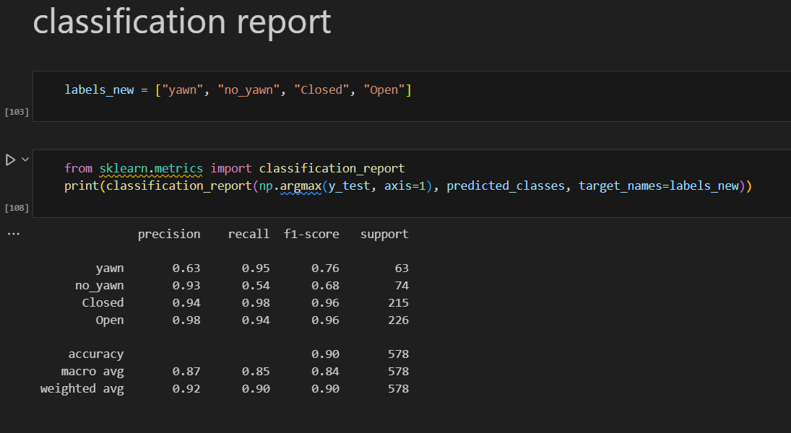

Slide 17
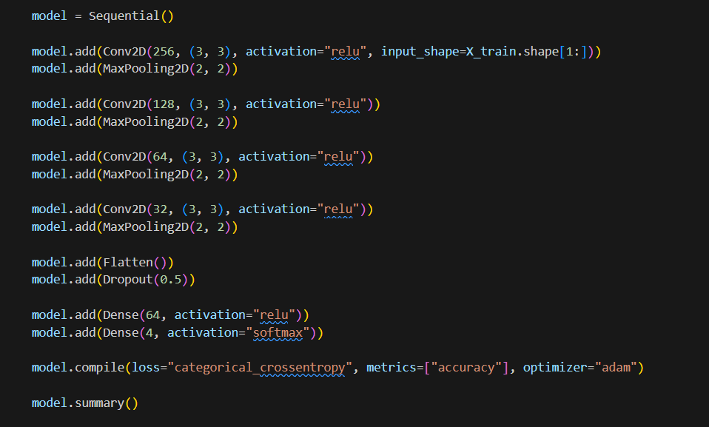

Slide 18
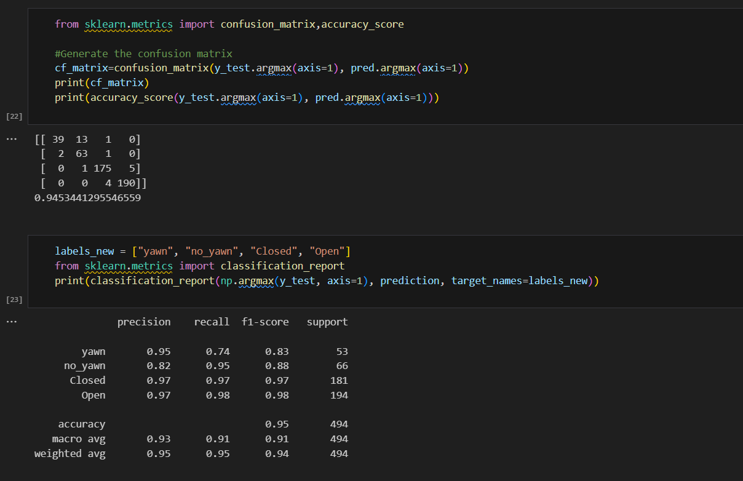

Slide 19
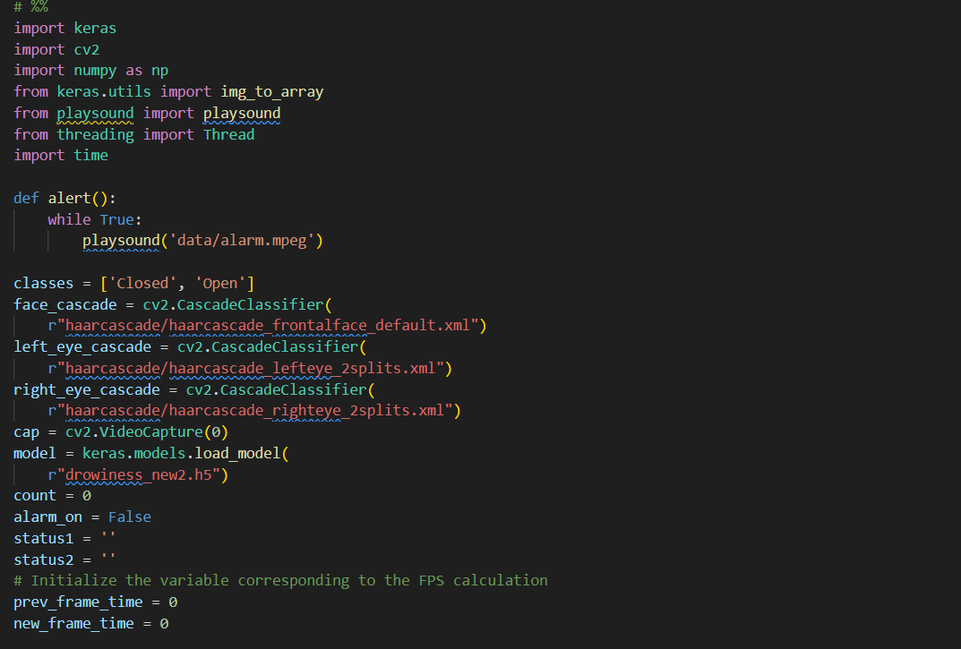
DETECTION

Slide 20
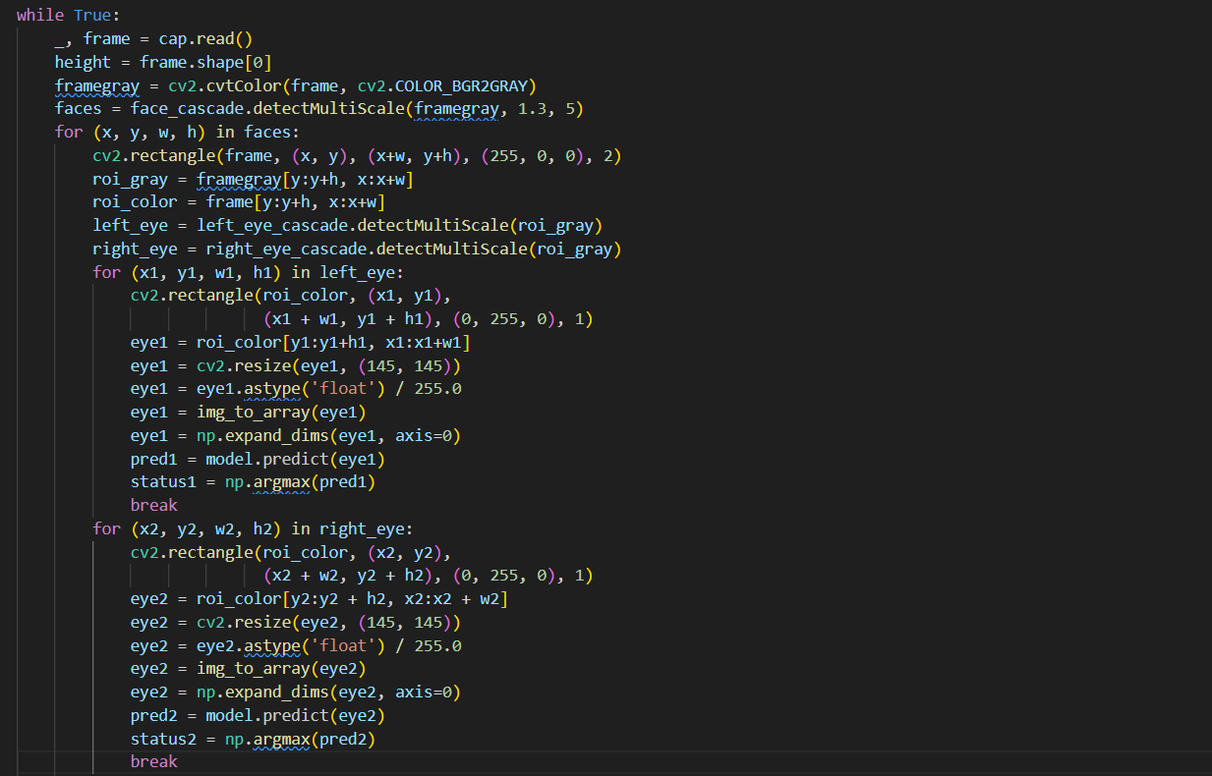

Slide 21
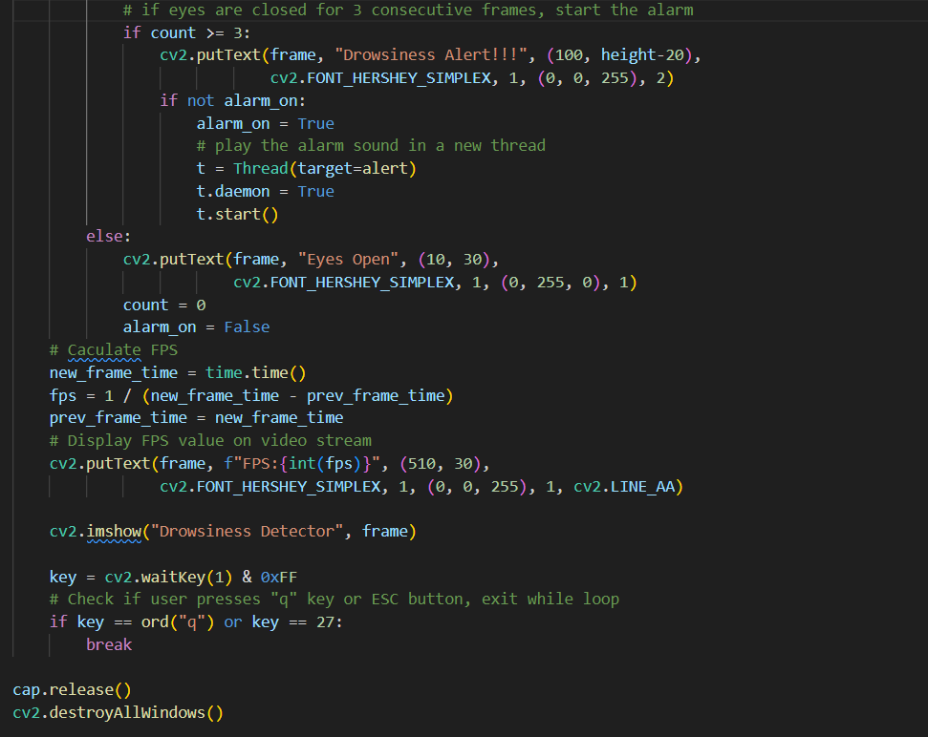

Slide 22
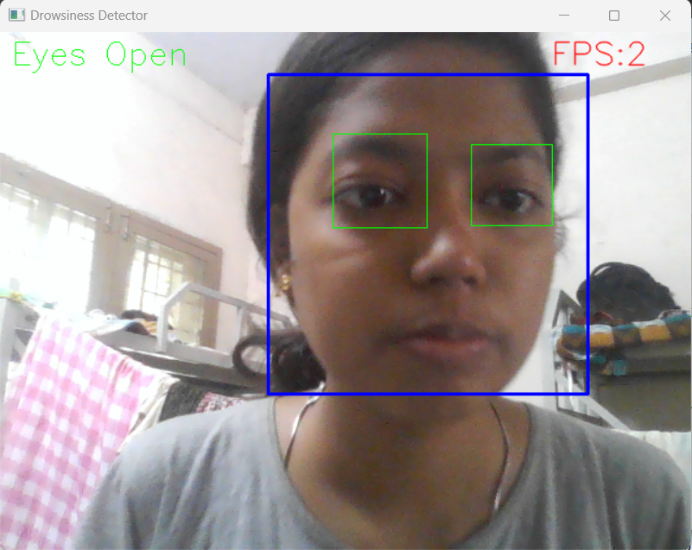
OUTPUT

Slide 23
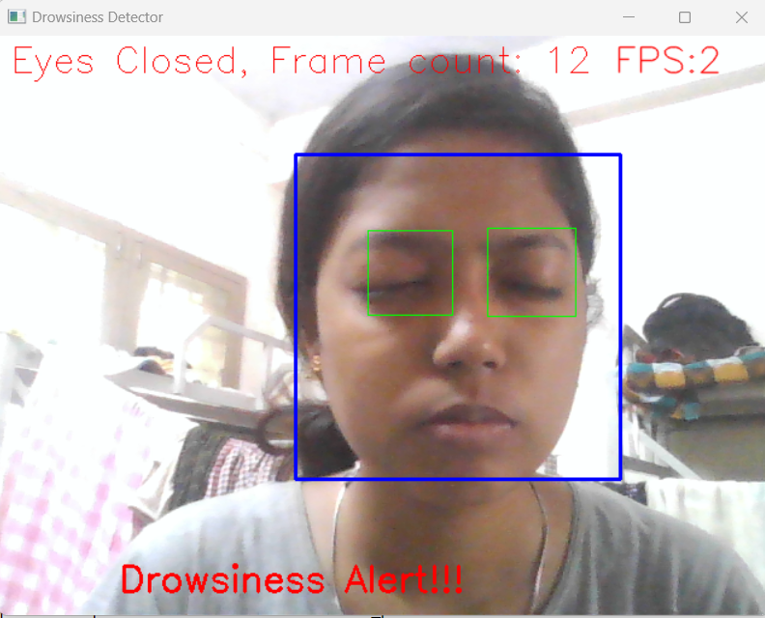

Slide 24
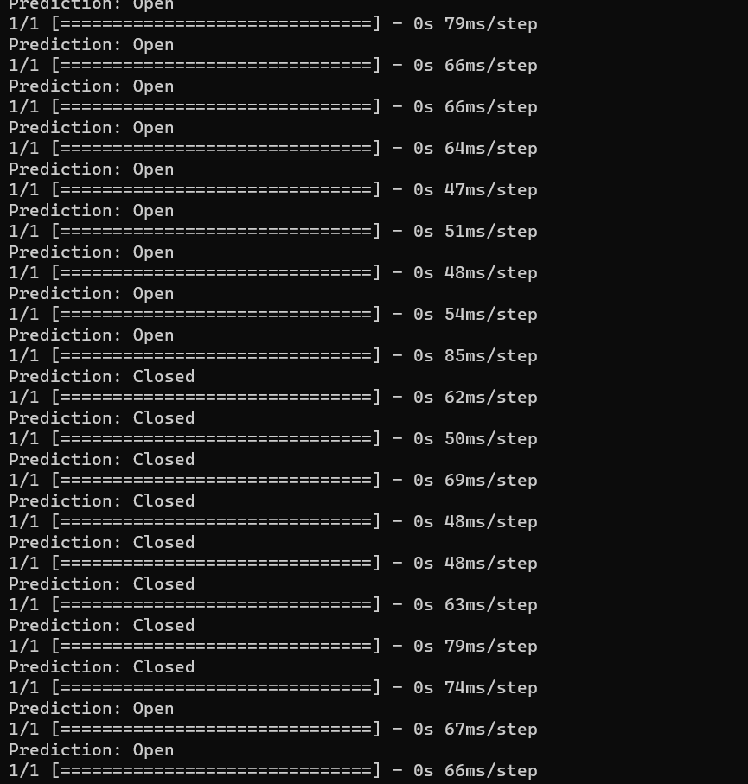

Slide 25
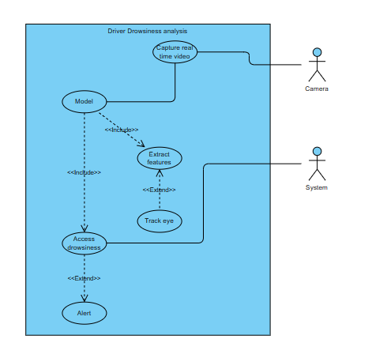
UML DIAGRAMS:
1.USE CASE DIAGRAM:

Slide 26
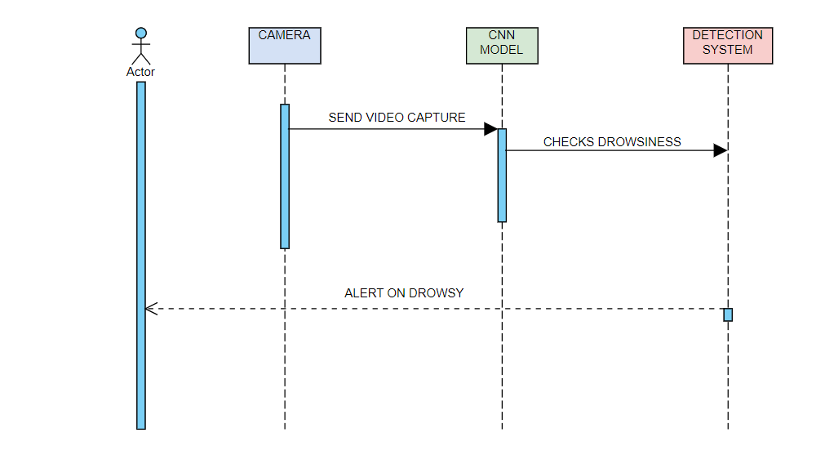
2.SEQUENCE DIAGRAM:

Slide 27
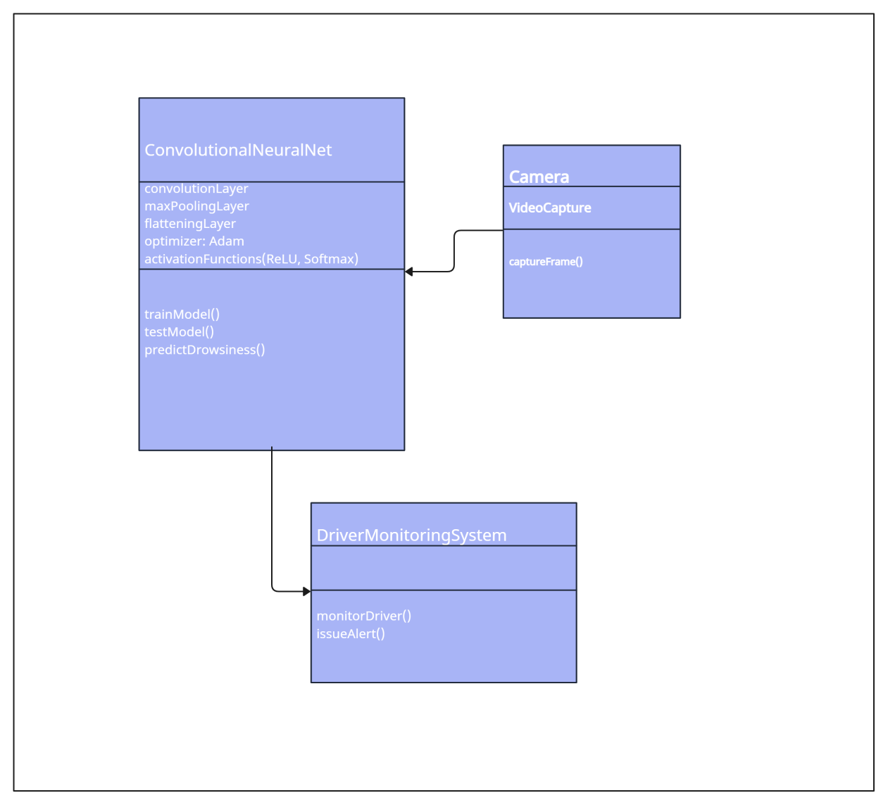
3.CLASS DIAGRAM:

Slide 28
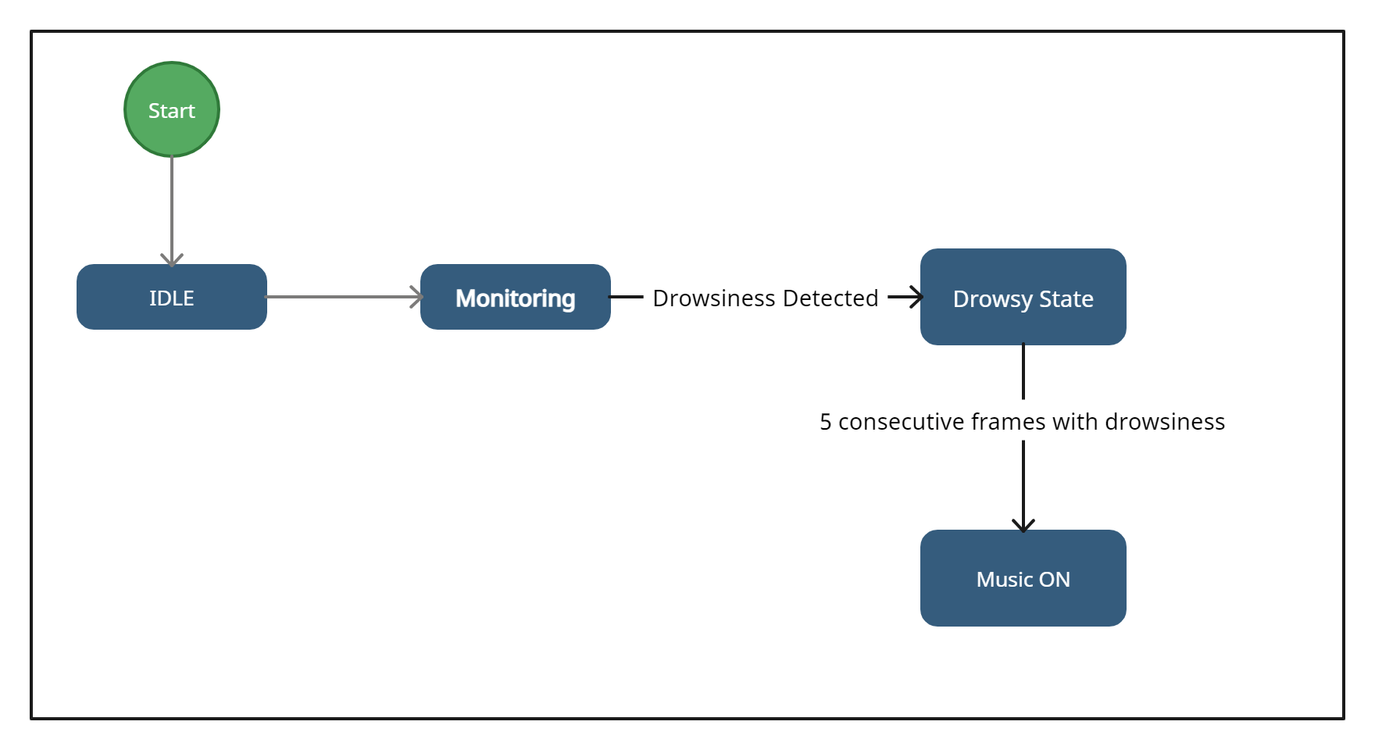
4.STATE DIAGRAM:

Slide 29
Conclusion:
The drowsiness detection system is capable of detecting drowsiness in quickly. The system which can differentiate
normal eye blink and drowsiness can prevent the driver from entering the state of sleepiness while driving. The
system works well irrespective of driver wearing spectacles and under low light conditions also. During
the monitoring, the system is able to decide if the eyes are closed or opened. When the eyes have been closed
for too long a warning signal is issued. The ultimate goal of the system is to check the drowsiness condition of the driver. Based on the eye movements of the driver, the drowsiness is detected and according to eye blink, the alarm will be generated to alert. By doing this, many accidents will be reduced and provides safety to the driver
and vehicle.
Future Scope:
We plan to further work on the project by adding a sensor to track the heart rate in order to prevent accidents caused due to sudden heart attacks to drivers.

Slide 30
REFERENCES
https://doi.org/10.22214/ijraset.2022.40895
(IJACSA) International Journal of Advanced Computer Science and Applications, Vol. 12, No. 7, 2021 844 | P a g e www.ijacsa.thesai.org Real-time Driver Drowsiness Detection using Deep Learning

